Slide 1






EMAIL SPAM DETECTION
Student Details
Name: SRIRAM R
NM Id:autle-01eee
College Name:KINGSTON ENGINEERING COLLEGE

Slide 2
EMAIL SPAM DETECTION
Disclaimer
The content is curated from online/offline resources and used for educational purpose only

Slide 3

Course Outline
EMAIL SPAM DETECTION
Abstract
Problem Statement
Aims, Objective & Proposed System/Solution
System Deployment Approach
Model Development & Algorithm
Future Scope
Video of the Project
Conclusion
Reference

Slide 4


EMAIL SPAM DETECTION
Abstract
Nowadays, a big part of people rely on available email or messages sent by the stranger. The possibility that anybody can leave an email or a message provides a golden opportunity for spammers to write spam message about our different interests .Spam fills inbox with number of ridiculous emails . Degrades our internet speed to a great extent .Steals useful information like our details on our contact list. Identifying these spammers and also the spam content can be a hot topic of research and laborious tasks. Email spam is an operation to send messages in bulk by mail .Since the expense of the spam is borne mostly by the recipient ,it is effectively postage due advertising. Spam email is a kind of commercial advertising which is economically viable because email could be a very cost effective medium for sender .With this proposed model the specified message can be stated as spam or not using Bayes’ theorem and Naive Bayes’ Classifier and Also IP addresses of the sender are often detected

Slide 5


EMAIL SPAM DETECTION
Problem Statement
Unwanted e-mails irritating internet connection
Critical e-mail message are missed and delayed Millions of compromised computers
It occupies more space in the cloud
Identity theft
Spam can crash mail servers and fil up hard drives

Slide 6

EMAIL SPAM DETECTION
Aim and Objective
Aim: The primary aim for email spam detection is to effectively identify and filter out unsolicited or unwanted emails, commonly known as spam, to protect users from malicious content, scams, phishing attempts, and other undesirable messages. This aim encompasses several specific

Slide 7
EMAIL SPAM DETECTION
Objectives
Minimize Inbox Clutter: Ensure that users receive only relevant and desired emails in their inbox, reducing the clutter caused by spam messages.
Prevent Security Threats: Protect users from potential security threats posed by spam emails, such as malware, viruses, and phishing attempts aimed at stealing sensitive information.
Enhance User Experience: Improve the overall user experience by reducing the annoyance and inconvenience caused by spam emails, allowing users to focus on important messages.
Maintain Email System Integrity: Preserve the integrity of the email system by preventing it from being overwhelmed by spam, which can degrade performance and consume valuable resources.
Protect Brand Reputation: Safeguard the reputation of email service providers, businesses, and individuals by preventing spam emails from tarnishing their brand image or credibility.

Slide 8

EMAIL SPAM DETECTION
Proposed Solution
In this system, to solve the problem of spam, the spam classification system is created to identify spam and nonspam. Since spammers may send spam messages many times, it is difficult to identify it every time manually .So we will be using some of the strategies in our proposed system to detect the spam. The proposed solution not only identifies the spam word but also identifies the IP address of the system through which the spam message is sent so that next time when the spam message is sent from the same system our proposed system directly identifies it as blacklisted based on the IP address. In the proposed model ,the web application is done using dot net and spam detection is done using machine learning .The web application consists of following modules
Notes:
‹#›

Slide 9
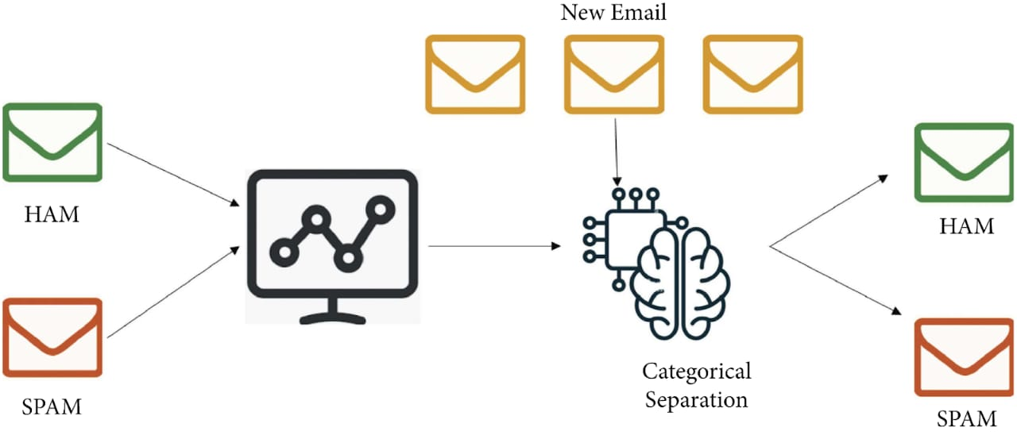
EMAIL SPAM DETECTION
System Deployment Approach
Notes:
‹#›

Slide 10
EMAIL SPAM DETECTION
Model Development & Algorithm
Dataset Description:
The dataset contains digital face images.
Size of dataset is 557*2
Categorized into two classes
Ham spam :messages
Notes:
‹#›

Slide 11
EMAIL SPAM DETECTION
Model Development & Algorithm
Data Collection:
Gather a dataset of emails that are labeled as spam or non-spam (ham).
Ensure that the dataset is diverse and representative of the types of emails the model will encounter in production.
Preprocessing:
Clean the text data by removing HTML tags, special characters, and other noise.
Tokenize the text into individual words or tokens.
Convert all words to lowercase.
Remove stop words and perform stemming or lemmatization to normalize the text.
Feature Extraction:
Use techniques like Bag-of-Words (BoW), Term Frequency-Inverse Document Frequency (TF-IDF), or word embeddings to represent the emails as numerical feature vectors.
Experiment with different feature representations to find the most effective ones for the task.
Notes:
‹#›

Slide 12

EMAIL SPAM DETECTION
Future Scope
he future work of email spam detection will likely focus on addressing emerging challenges and leveraging advanced technologies to improve detection accuracy, efficiency, and user experience. Here are some potential areas of future research and development
● Deep Learning Techniques
● Unsupervised Learning Approaches
● Multi-Modal Analysis
● Contextual Analysis
● Adversarial Defense Mechanisms
● Privacy-Preserving Techniques
● Real-Time Feedback Loops
Notes:
‹#›

Slide 13
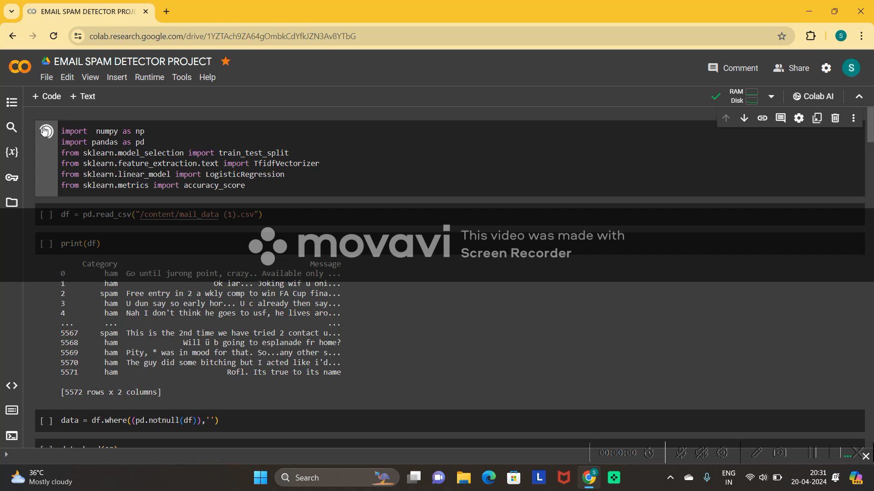
EMAIL SPAM DETECTION
Video of the Project
Notes:
‹#›

Slide 14

EMAIL SPAM DETECTION
Conclusion
Email has been the most important medium of communication nowadays, through internet connectivity any message can be delivered to all aver the world. More than 270 billion emails are exchanged daily, about 57% of these are just spam emails. Spam emails, also known as non-self, are undesired commercial or malicious emails, which affects or hacks personal information like bank ,related to money or anything that causes destruction to single individual or a corporation or a group of people. Besides advertising, these may contain links to phishing or malware hosting websites set up to steal confidential information. Spam is a serious issue that is not just annoying to the end-users but also financially damaging and a security risk. Hence this system is designed in such a way that it detects unsolicited and unwanted emails and prevents them hence helping in reducing the spam message which would be of great benefit to individuals as well as to the company .In the future this system can be implemented by using different algorithms and also more features can be added to the existing system
Notes:
‹#›

Slide 15
EMAIL SPAM DETECTION
Reference
[1] S. H. a. M. A. T. Toma, "An Analysis of Supervised Machine Learning Algorithms for Spam Email Detection," in International Conference on Automation, Control and Mechatronics for Industry 4.0 (ACMI), 2021
[2] S. Nandhini and J. Marseline K.S., "Performance Evaluation of Machine Learning Algorithms for Email Spam Detection," in International Conference on Emerging Trends in Information Technology and Engineering (ic-ETITE), 2020
[3] A. L. a. S. S. S. Gadde, "SMS Spam Detection using Machine Learning and Deep Learning Techniques," in 7th International Conference on Advanced Computing and Communication Systems (ICACCS), 2021, 2021
[4] V. B. a. B. K. P. Sethi, "SMS spam detection and comparison of various machine learning algorithms," in International Conference on Computing and Communication Technologies for Smart Nation (IC3TSN), 2017
Notes:
Reference
These are the references for this session.

Slide 16
EMAIL SPAM DETECTION
Thank you!
Notes:
‹#›

